Slide 1
Final presentation:
02/09/2020, Milano
Alessio Russo
Carmelo Valore

Slide 2
Dynamic bicycle model
Introduction /objectives
2
Alessio Russo, Carmelo Valore
Notes:
Inserire qui gli slip

Slide 3
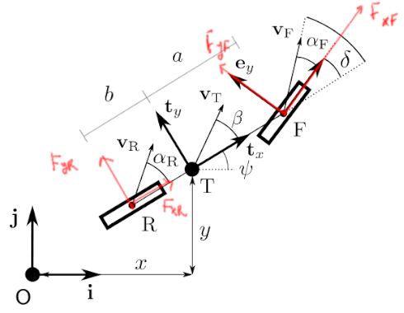
Dynamic bicycle model
Dynamic bicycle model
Pacejka tyre model
Aerodynamic forces
Fuel consumption model
Tyre wear model
Banking
Slipstream
3
Alessio Russo, Carmelo Valore
Notes:
Inserire qui gli slip

Slide 4
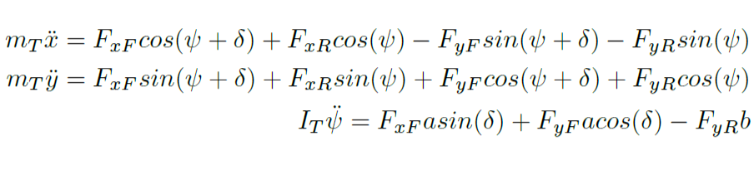
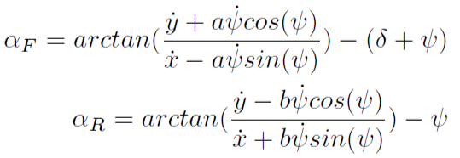
Dynamic bicycle model
Initial equations
Equilibrium with respect to the inertial frame Oij
4
Alessio Russo, Carmelo Valore
Notes:
Inserire qui gli slip

Slide 5
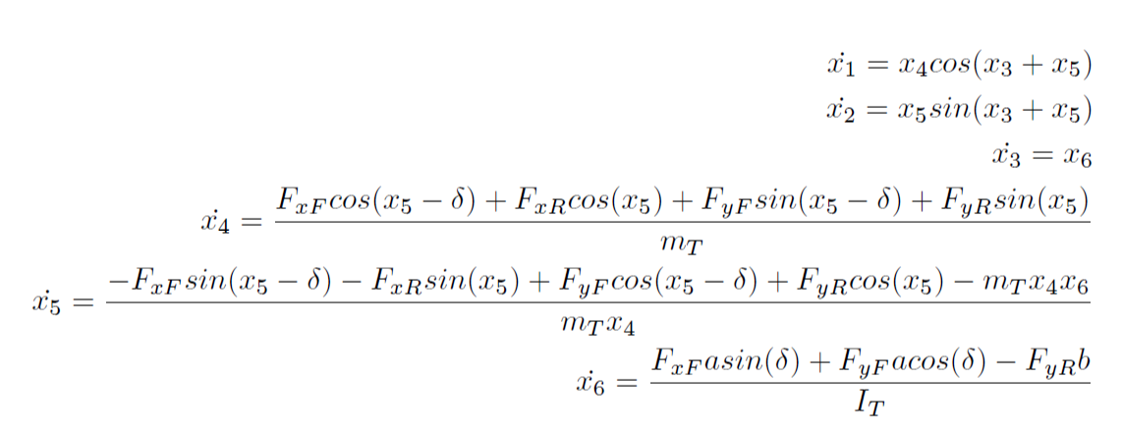
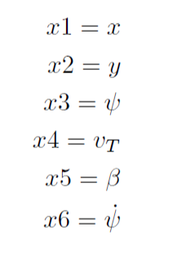
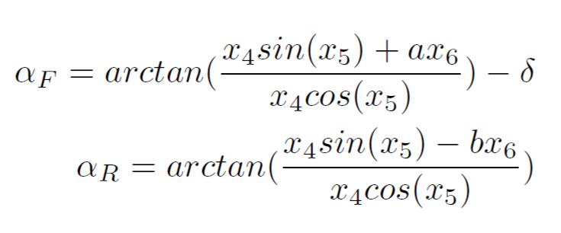
Dynamic bicycle model
We set the followings as the states of the model
So we derived the state equations
5
Alessio Russo, Carmelo Valore
Notes:
Inserire qui gli slip

Slide 6
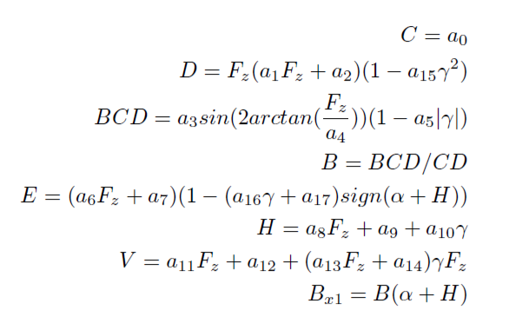
Pacejka tyre model
Pacejka formula derived
from experimental data
Takes as input:
the slip angle α
vertical load on the tyre F_{z}
the amplitude D
6
Alessio Russo, Carmelo Valore
Notes:
Inserire qui gli slip

Slide 7
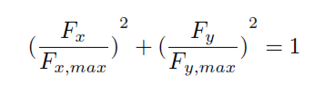
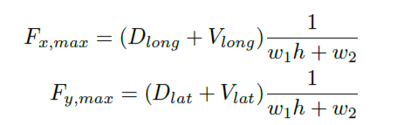
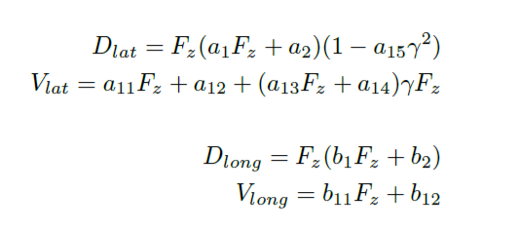
Friction ellipse (slide 1)
The physics of the tyre model is represented
through the friction ellipse
The ellipse dimension depends on:
the wear of the tyre h
the vertical load F_{z}
w₁ and w₂ that are parameters that regulate the scaling according to h
7
Alessio Russo, Carmelo Valore
Notes:
Inserire qui gli slip

Slide 8
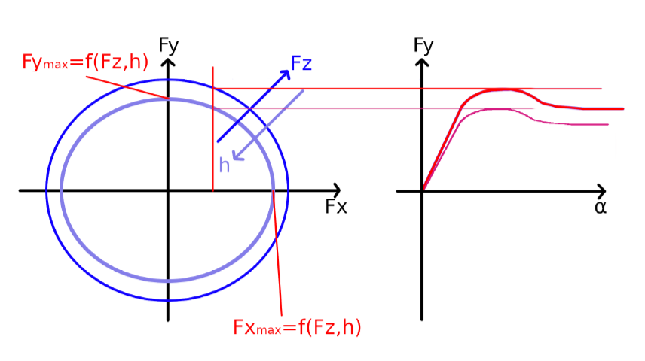
Friction ellipse (slide 2)
The control variable F_{x} determines F_{y} on the ellipse
The output of the Pacejka will be scaled according to F_{y}
We set the peak of the Pacejka (D_{lat} + V_{lat}) = F_{y}
8
Alessio Russo, Carmelo Valore
Notes:
Inserire qui gli slip

Slide 9
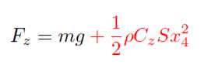
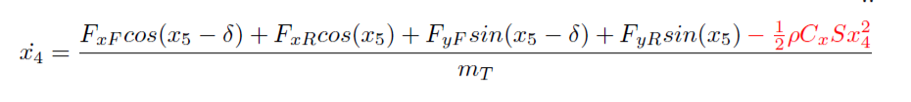
Aerodynamic forces
The drag force impacts on the body acceleration equation
Its contribution is negative because the applied force is opposite to the vehicle velocity
The contribution of the lift force increases the vertical load
Linear dependency with air density, drag/lift coefficient and area S of the considered surface. Square dependency with body velocity
9
Alessio Russo, Carmelo Valore
Notes:
Inserire qui gli slip

Slide 10
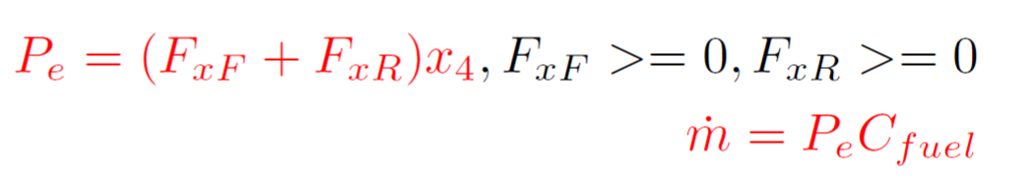
Fuel consumption model
Fuel consumption has been modelled by taking into account the power output
P = 0 while braking
P is multiplied by a C_{fuel} coefficient to express fuel consumption
10
Alessio Russo, Carmelo Valore
Notes:
Inserire qui gli slip

Slide 11
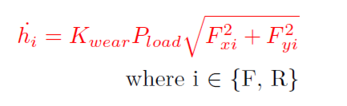
Tyre wear
Based on the Archard model for tyre wear
The model has been converted in order to take into account, instead of the sliding velocity, the forces acting on the wheels
So it depends on:
The vertical load pressure P_{load} = F_{z} / Tyre_contact_area
Forces F_{x} and F_{y} acting on the wheel
K_{wear} coefficient opportunely chosen
11
Alessio Russo, Carmelo Valore
Notes:
Inserire qui gli slip

Slide 12
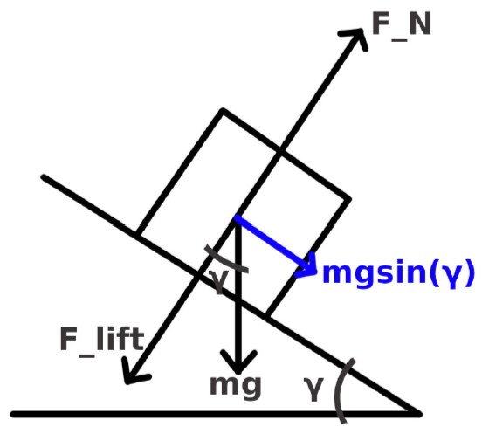
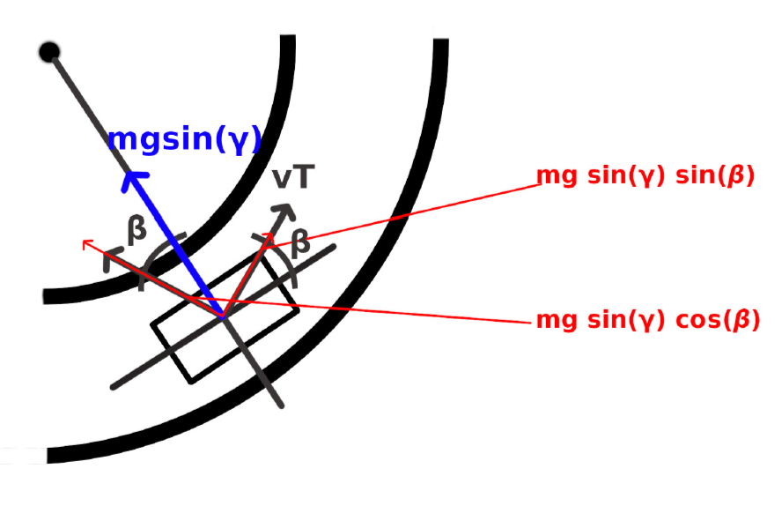
Banking (slide 1)
Banking has been considered in the model equations to take into acount the shape of Indianapolis circuit
To simplify the model, the car is assumed to always travel with in parallel with respect to the tangent of the curve. In this way we only consider the projection of the weight force along the road surface
Lateral view
Top view
12
Alessio Russo, Carmelo Valore
Notes:
Inserire qui gli slip

Slide 13
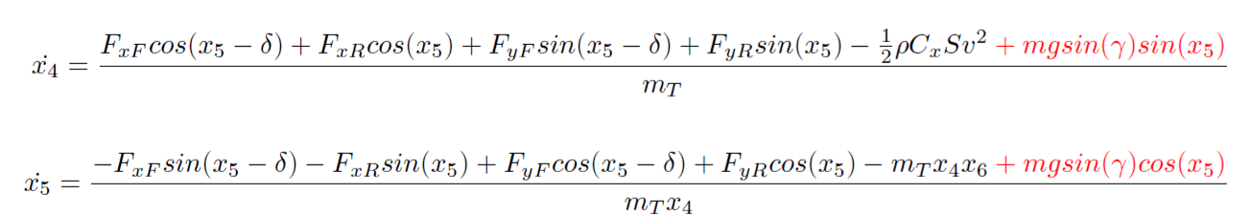
Banking (slide 2)
Given our assumptions, the projection mg*sin(γ) will
be directed to the center of the curve. Thus, we
projected it again to consider it into our state equations
13
Alessio Russo, Carmelo Valore
Notes:
Inserire qui gli slip

Slide 14
Slipstream
For slipstream different assumptions have been made to determine the change of aerodynamic coefficients
Different values considered if the vehicle is traversing straight paths or curvature paths
straight path: the drag force decrease is of 15% while the lift force decrease is of 30%
curvature path: the drag force decrease is of 15% while the lift force is left unchanged
14
Alessio Russo, Carmelo Valore
Notes:
Inserire qui gli slip

Slide 15
Validation of the model
Some simulations have been run to test and validate the presented model
More details in the PDF
15
Alessio Russo, Carmelo Valore
Notes:
Inserire qui gli slip

Slide 16
Control
To make the vehicle move according to a desired trajectory it is necessary to design a controller
We first need to linearize the model to design the controller on it
We choose as operating point for linearization a point where we assume that:
the vehicle is moving on a straight path
the vehicle has a constant longitudinal speed
16
Alessio Russo, Carmelo Valore

Slide 17
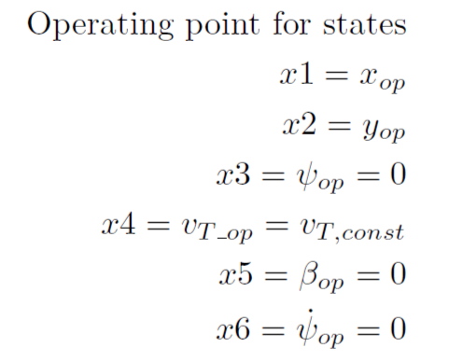
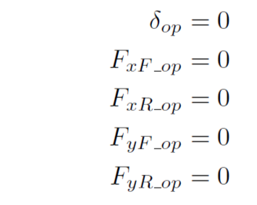
Linearized dynamic bicycle model
Non linear equations of the model
The values of states and inputs at the considered operating point are
17
Alessio Russo, Carmelo Valore
Notes:
Inserire qui gli slip

Slide 18
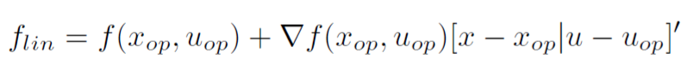
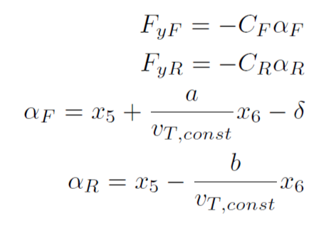
Control
Expanding the system in a Taylor series we have
Considering linear tyre model and linear version of the slip angles
18
Alessio Russo, Carmelo Valore

Slide 19
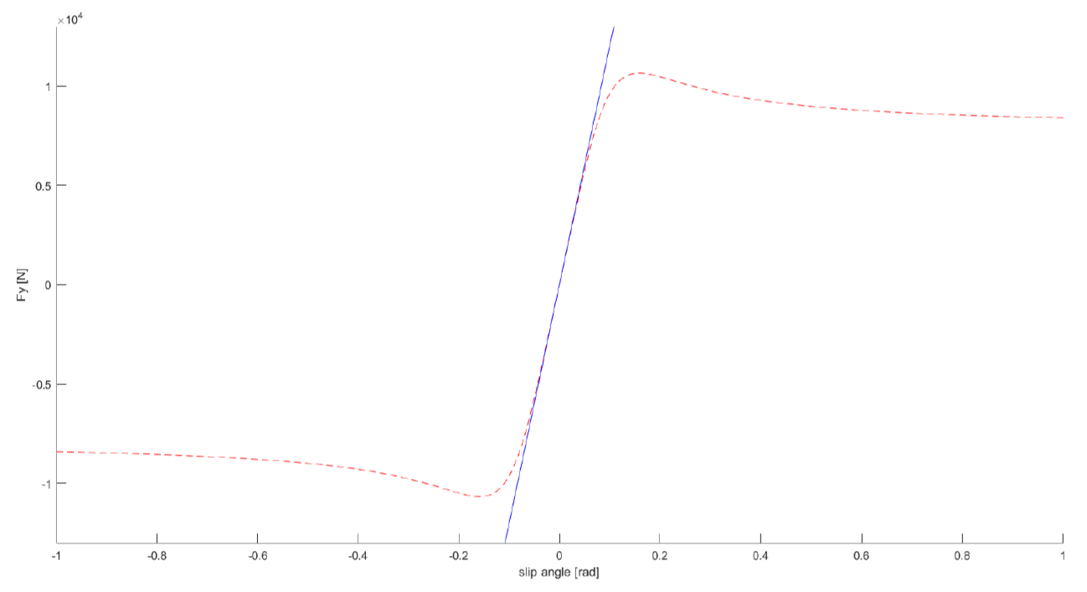
Control
The values for C_{F} and C_{R} have been chosen to best approximate the Pacejka tyre model in the case of small angles according to the mean vertical load on each wheel
19
Alessio Russo, Carmelo Valore

Slide 20
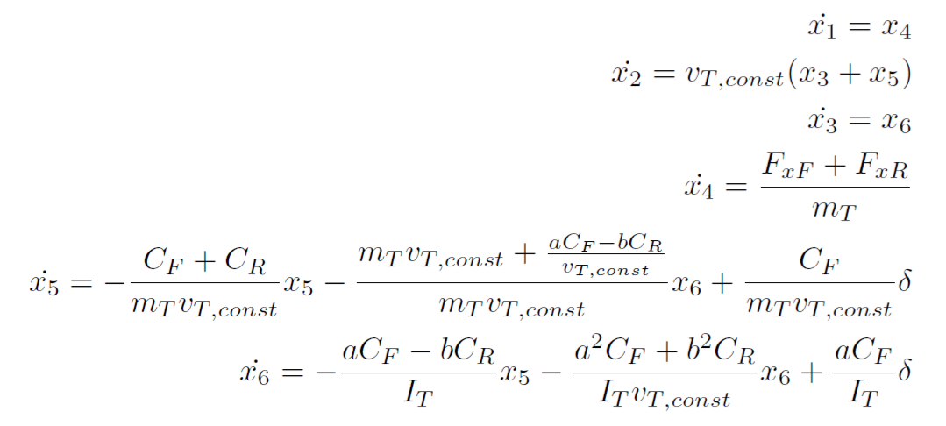
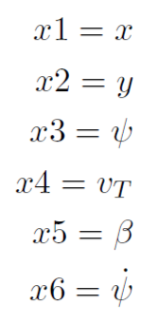
Control
So we obtain the linearized model
20
Alessio Russo, Carmelo Valore

Slide 21
Control
In our particular case it is possible to split the control logic into two independent controllers
Longitudinal controller: by controlling force on the rear wheel F_{xR} , it makes the vehicle follow a given velocity profile along the predefined trajectory
Lateral controller: by controlling the steering angle δ, it tries to minimize the lateral error with respect to a virtual point determined by the vehicle status and the lookahead distance
21
Alessio Russo, Carmelo Valore
Notes:
Inserire qui gli slip

Slide 22
Longitudinal control
The goal of the longitudinal controller is to make the vehicle follow a given speed profile
The speed profile is provided through an array of reference velocities indexed by the curvilinear abscissa
The reference velocity in a specific point of the track is found by looking up this array searching for the nearest point in the trajectory from the actual position of the vehicle
To design the regulator we used the transfer function from F_{xR} to v_{T} in the linearized model
SCREENSHOT SIMULINK
22
Alessio Russo, Carmelo Valore

Slide 23
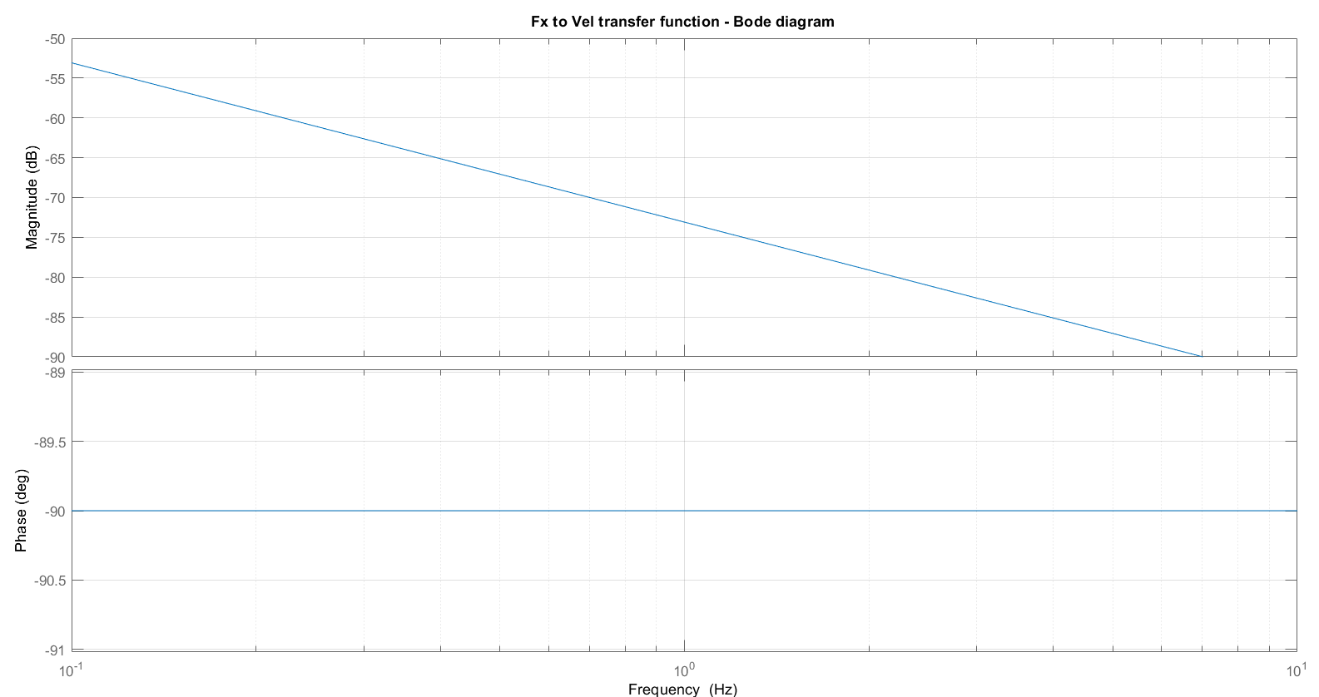
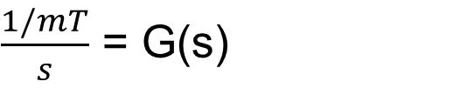
Longitudinal control
$\frac{1/mT}{s}$ = G(s)
Transfer function between F_{xR} and v_{T}:
23
Alessio Russo, Carmelo Valore

Slide 24
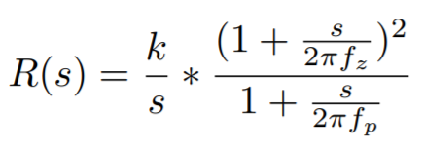
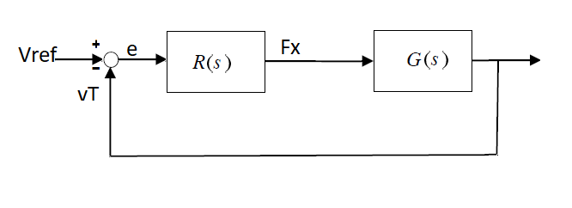
Longitudinal control
Regulator designed in order to have an open loop function that:
has a bandwidth of at least 1 [Hz]
rejects ramp disturbances
is stable when the loop is closed
24
Alessio Russo, Carmelo Valore

Slide 25
Longitudinal control
Tuned parameters are:
f_{z} = 0.06 [Hz]
f_{p} = 0.03 [Hz]
k = 5.2 x 10³
The double zeros were chosen to be coincident for tuning simplicity and were added to obtain a raise of the phase margin in order for the system to be stable. The pole at frequency f_{p} was added to obtain the desired bandwidth and to have a causal regulator.
25
Alessio Russo, Carmelo Valore

Slide 26
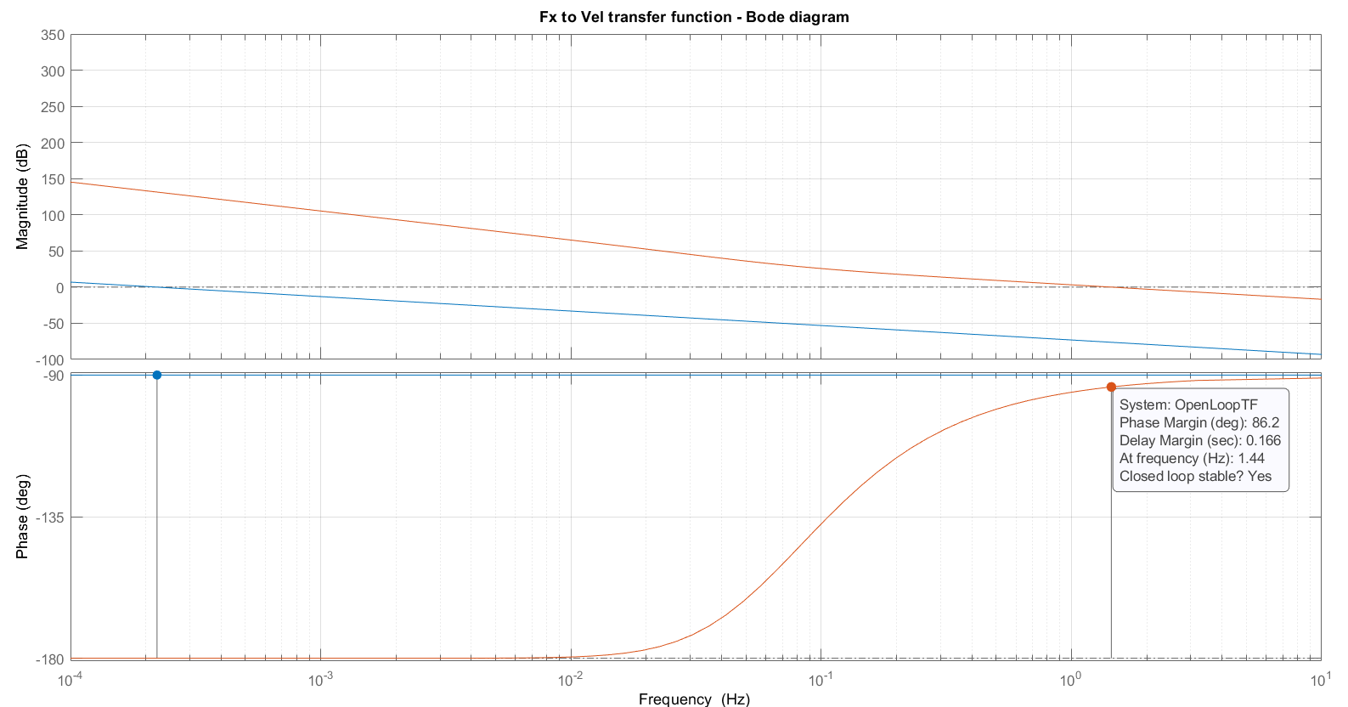
Bode plot of L(s) function
26
Alessio Russo, Carmelo Valore

Slide 27
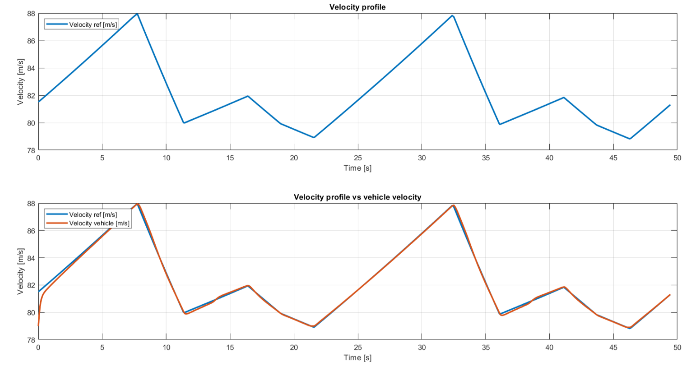
Longitudinal control - Tracking velocity results
27
Alessio Russo, Carmelo Valore

Slide 28
Lateral control
The goal of the lateral controller is to minimize the lateral error with respect to a virtual point determined by the vehicle’s position, vehicle’s heading direction and the lookahead distance
The idea behind the virtual point is to foresee where the car will be in the «next instants» and to steer accordingly in order to have a better path tracking
IMMAGINE NOSTRA DEL LOOKAHEAD DISTANCE
28
Alessio Russo, Carmelo Valore

Slide 29
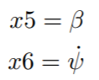
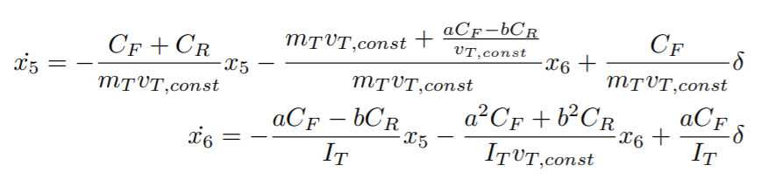
Lateral control
To build the lateral controller a slight modification in the considered state space model has been done
From the linearized model we first neglect the longitudinal dynamics and consider
29
Alessio Russo, Carmelo Valore

Slide 30
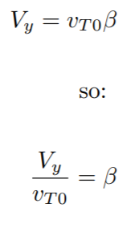
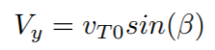
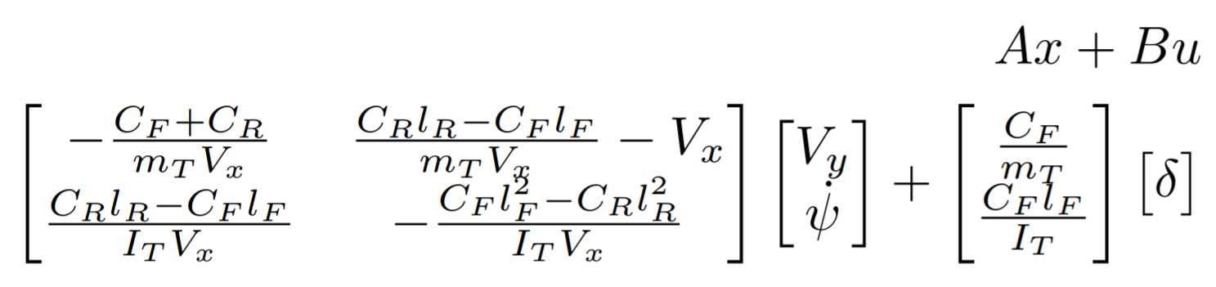
Lateral control
Then we make a change in the states by exploiting the following assumption that v_{T0} corresponds to V_{x} given that the vehicle is traversing a straight path and β is small
Thus obtaining
30
Alessio Russo, Carmelo Valore

Slide 31
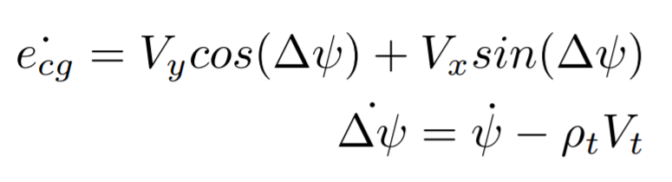
Lateral control
To this model two states and an input ρ (for the curvature) have been added to take into consideration the dynamic of the error
e_{cg} represents the lateral positioning error with respect to the center of gravity
∆ψ is the heading angle error, representing the difference between the desired yaw angle and the actual one
31
Alessio Russo, Carmelo Valore

Slide 32
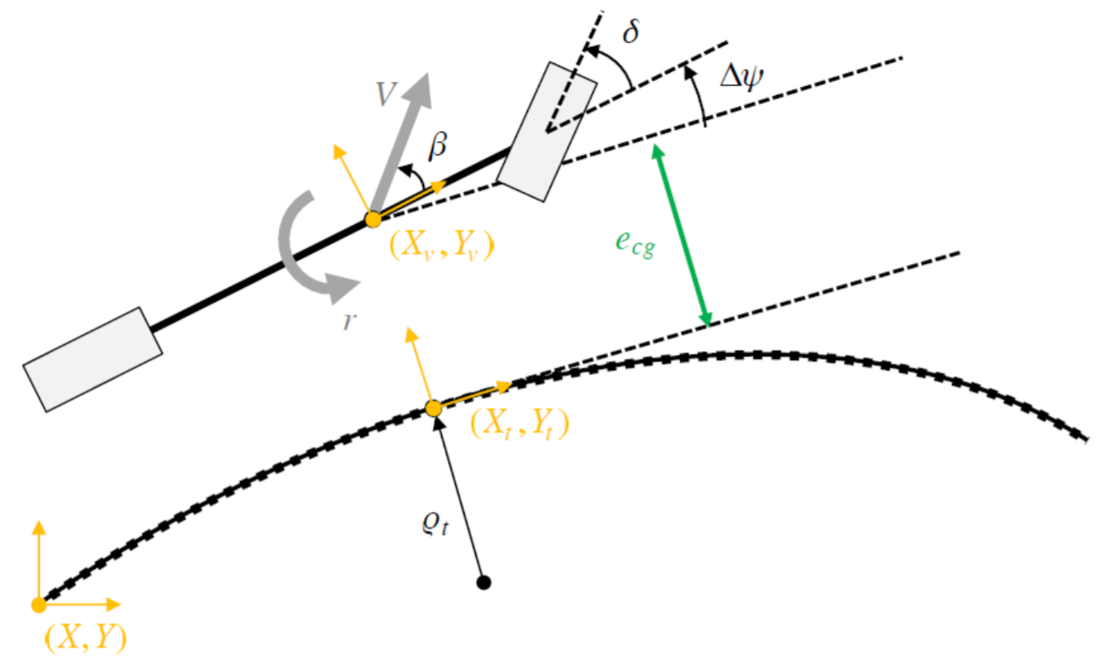
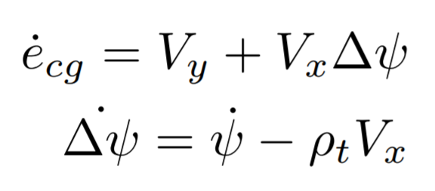
Lateral control
Using the small angle assumption and considering that the vehicle is well tracked we can also simplify
32
Alessio Russo, Carmelo Valore

Slide 33
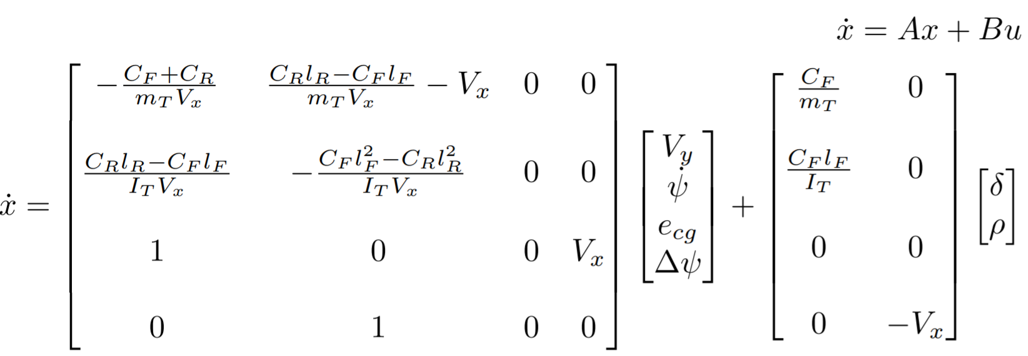
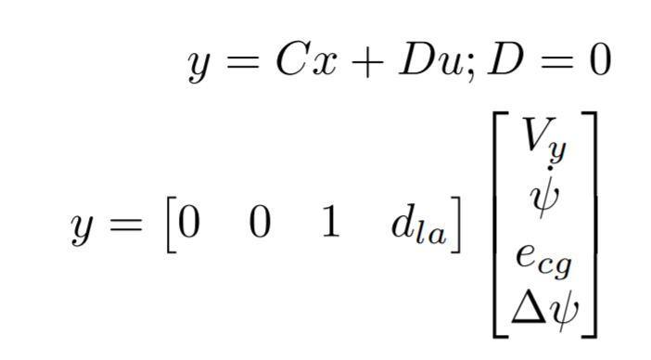
Lateral control
So we have the following state space model having as output the error on the lookahead e_{la} that will be the sum of e_{cg} and of the error determined by the lookahead distance d_{la}*∆ψ
33
Alessio Russo, Carmelo Valore

Slide 34
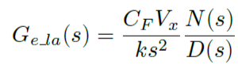
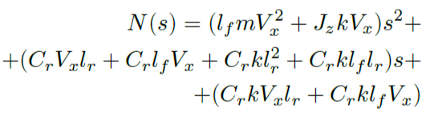
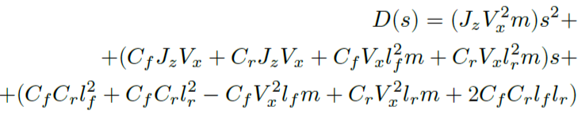
Lateral control
The transfer function obtained from the steering angle δ and the lateral error e_{la} error is
With N(s) and D(s):
34
Alessio Russo, Carmelo Valore

Slide 35
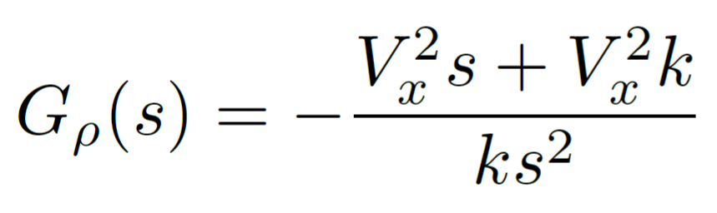
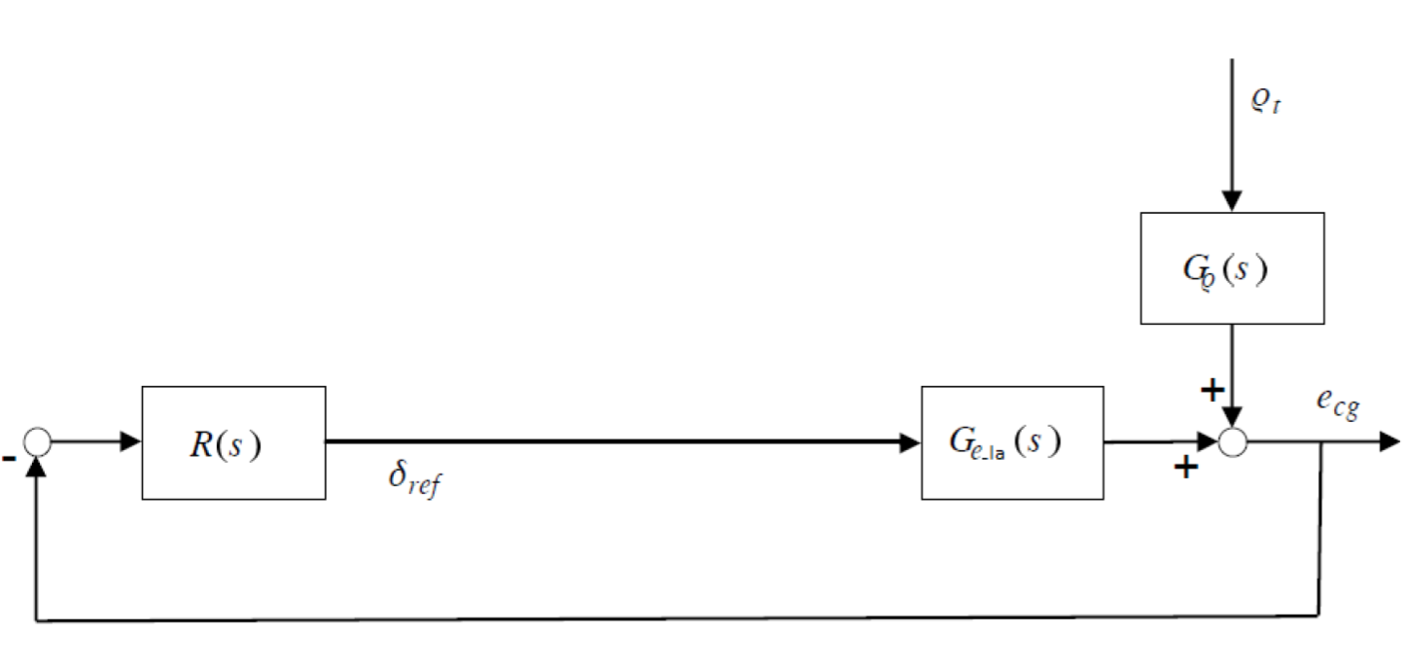
Lateral control
The transfer function obtained from the curvature ρ and the lateral error e_{la} error is
And the block diagram is:
35
Alessio Russo, Carmelo Valore

Slide 36
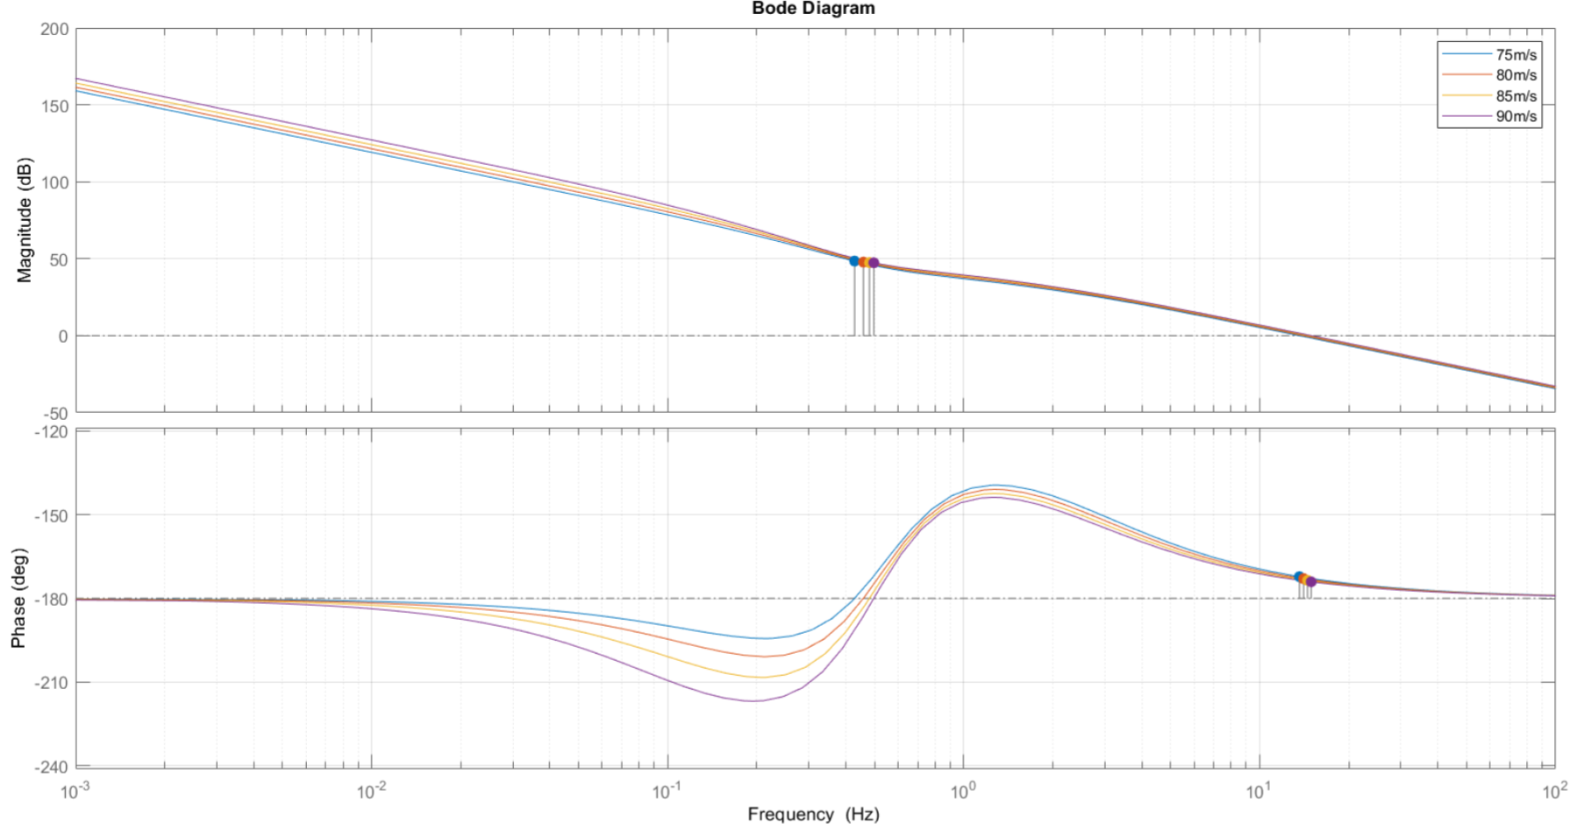
Bode plot of the plant G(s) at different velocities
36
Alessio Russo, Carmelo Valore

Slide 37
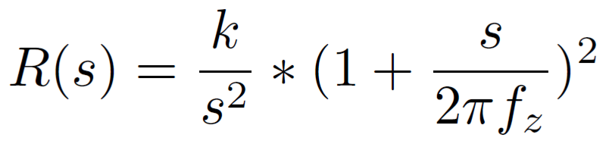
Lateral controller
Starting from the transfer function of the plant, the following regulator R(s) has been designed with tuned parameteres:
f_{z} = 0.01 [Hz]
k = 2*10⁻⁴
By combining R(s) and G(s) we obtain:
a closed-loop stable system
a system able to rejects step curvature disturbances
The second integrator has been added during the testing phase to overwhelm the non-linearity conditions
No need for rescheduling since bandwidth at different velocities is very similar
37
Alessio Russo, Carmelo Valore

Slide 38
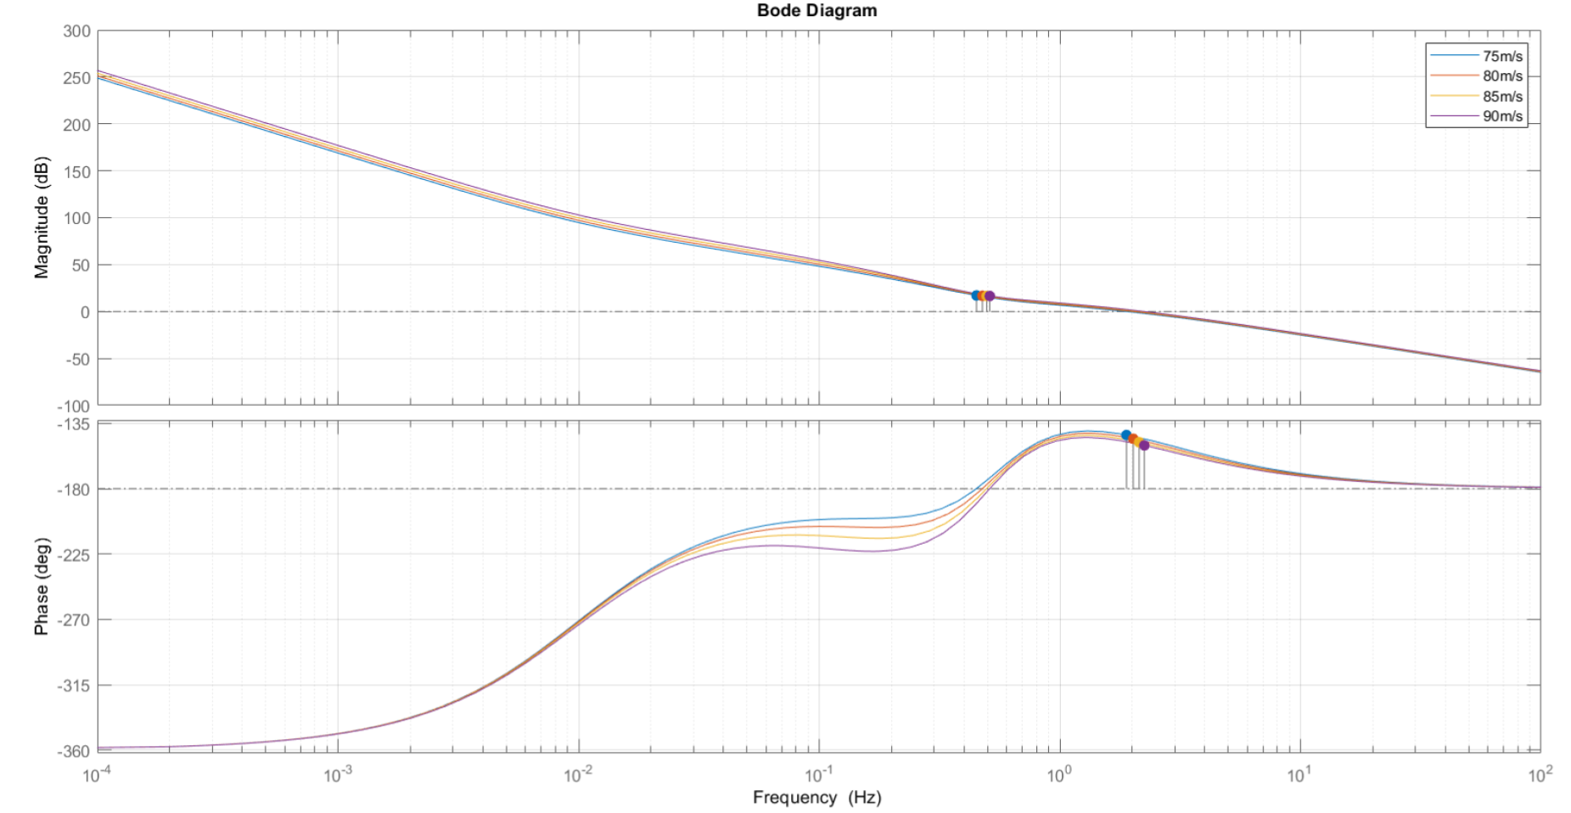
Bode diagram of L(s) at different velocities
38
Alessio Russo, Carmelo Valore

Slide 39
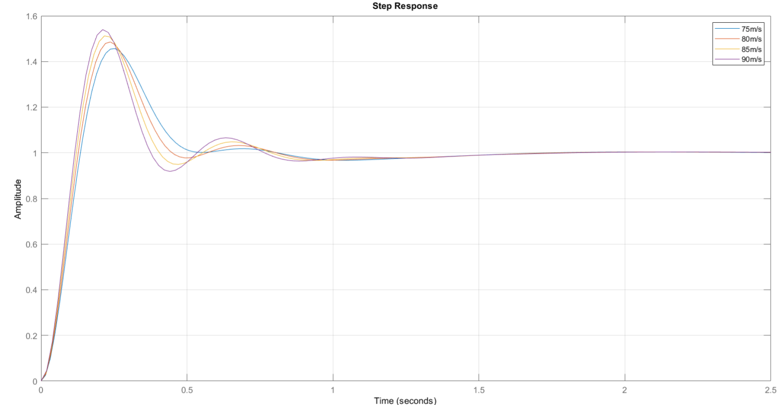
Step response of L(s) at different velocities
39
Alessio Russo, Carmelo Valore
Notes:
Senza lookahead con il regolatore di mori con gain cambiato a 0.01, le funzioni sono stabili ma ci sono oscillazioni forti già in partenza, senza feed-forward

Slide 40

Lateral controller
Lookahead varies instantly according to the velocity V_{x} scaled by a factor 1/k with k = 2
The feed-forward mechanism has been implemented
the value of the curvature referred to the current position of the vehicle is multiplied by the value C
40
Alessio Russo, Carmelo Valore

Slide 41

Lateral controller
Final block diagram
41
Alessio Russo, Carmelo Valore

Slide 42

Lap simulation
After the design phase of the two controllers, they have been tested with the original non-linear model and the results are shown in the following
42
Alessio Russo, Carmelo Valore

Slide 43

Lap simulation – speed profile tracking
43
Alessio Russo, Carmelo Valore

Slide 44

Lap simulation – Lateral error on center of gravity
44
Alessio Russo, Carmelo Valore

Slide 45

Lap simulation – Lateral error on lookahead
45
Alessio Russo, Carmelo Valore

Slide 46

Lap simulation – Controlled steering angle
46
Alessio Russo, Carmelo Valore

Slide 47
Meeting 7: Lateral Control
47

